Slide 1
Usain Bolt Breaks 100-Meter World Record Twice
Students’ Name
Institution Affiliation

Slide 2
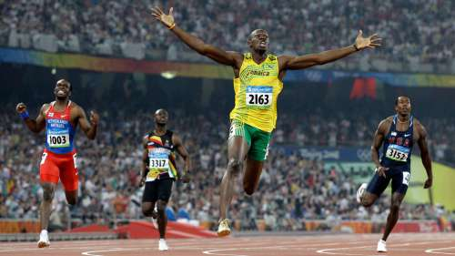
Usain Bolt Breaks 100-Meter World Record Twice
Introduction
The current Olympic 100-meter champion and world record holder is Usain Bolt, who broke the world record twice.
The event has featured a large number of different world record holders in the past years until the forthcoming of Usain Bolt.
The progressive record holders for the previous years before Bolt emerged had raised many questions including, what will be the shortest time be and where are those sprinters to break the records that have been achieved by others.

Slide 3

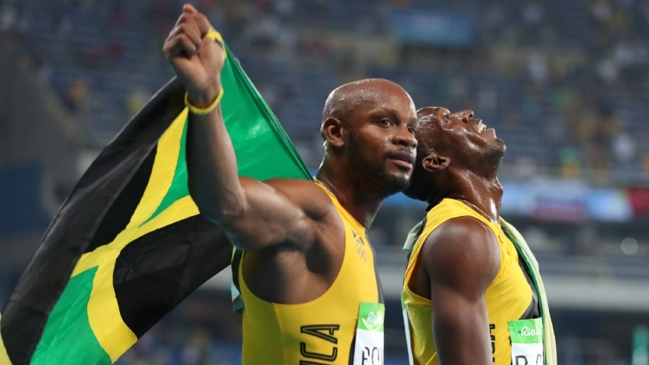
History of the 100- meter record holders for six years.
In 2002 in Paris, an American Tim Montgomery made his best mark against his rivals by finishing the race in 9.78 seconds.
In 2005, Asafa Powell broke the 100-meter world record by completing the race at 9.77 seconds in Athens, making a difference of 1 microsecond on the previous record that was set by Tim. However, this was not the end; Asafa emerged again and proved his record in 2007 (Top end 2014). He broke his record in Riet, Italy making a complete 100-meter race with only 9.74 seconds.
https://www.sportsmax.tv/media/k2/items/cache/asafa-p_XL.jpg
https://arc-anglerfish-arc2-prod-tronc.s3.amazonaws.com/public/WLF3S7WMXBE7FCNTV7L7K5IVUI.jpg

Slide 4

Cont.…
In 2008 to 2009, sprinter Usain Bolt dominated as the world record holder while breaking his record.
This is clearly shown with a significant improvement in speed, whereby in 2008, he completed the race at 9.69, achieving his 1st Olympic gold.
In 2009, he made an incredible world record beating performance in the finals in Beijing during the world championship setting a record of 9.58 seconds (Top end 2014).

Slide 5
How the event impacted the World
Scientists are calling it the "Usain Bolt Effect" because he has significantly improved the average performance of the world's top sprinters, who are now running about 1 per cent faster than they did prior to Bolt's explosive appearance in 2009 – a significant margin at this distance
The record set by Bolt was a headlight that indicated athletes have the ability to perform to their best.
It raised a significant focus on Olympic marathon.
Athletes gained confidence and motivations that they can make it and no human is limited to his speed.
The pursuit of the world's best sprinter has forced competition to be quicker than ever just to keep up.

Slide 6
Future reflection of 100 meter race
The progressive record held by different printers, have shown an exciting aspect, especially on athletes' speed that has been increasing yearly.
This is a clear indication that 100 meters runners are approaching the limits of possibility.
As the world becomes more advanced with technology, people invent training tools that can improve human speed and the running tracks are well designed to support human efforts.

Slide 7
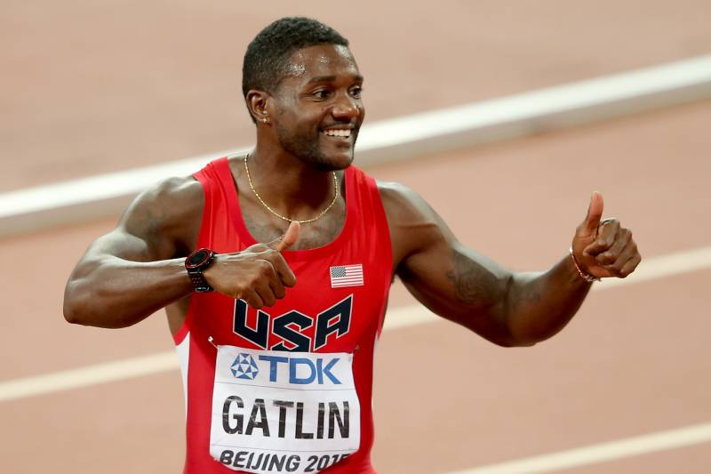
Cont.…
Even though Bolt dominated the sprint event in the last two Olympic competitions, there is great hope in the future that record will be broken.
According to Jones (2016), Justin Gatlin, an American sprinter, recently ran the 100 meters in 9.45 seconds, which was top speed on Usain Bolts' record.
Although there have been allegations in social media that he was assisted by the fans who were blowing out guts of air to improve his momentum, I believe it is an indication that in the coming years, he will make it.
Justin Gatlin
https://img.bleacherreport.net/img/images/photos/003/578/610/hi-res-f5cba38838e64c103dbc39bd0992af48_crop_north.jpg?h=533&w=800&q=70&crop_x=center&crop_y=top

Slide 8
How to boost athletes performance
The footwork in a 100m sprint is dependent to the following processes; the rate of production and consumption of energy in the body.
The speed at which electrical signals reaches the muscles, as well as the rate at which calcium initiates contraction and relaxation of muscles.
Other factors that improve athlete performance are; nutrition, methods of training, technology, and psychology set up.

Slide 9
References
Matt Jones (2016). Athletics. Justin Gatlin 'Breaks' Usain Bolt's World 100M Record on Japanese Show Kasupe! Retrieved: https://bleacherreport.com/articles/2620872-justin-gatlin-breaks-usain-bolts-world-100m-record-on-japanese-show-kasupe.
The conversation (2012). Is there a limit to athletic performance? Retrieved from: http://theconversation.com/is-there-a-limit-to-athletic-performance-8073.
Top-end (2014). Article on 100m World Records. https://www.topendsports.com/sport/athletics/record-100m.htm
Watch Athletes (2016). Today in History: Usain Bolt Breaks 100m World Record twice. https://www.watchathletics.com/article/9181/today-in-history-usain-bolt-breaks-100m-world-record-twice/.
Steve C (2012). Article on Independent. The Bolt Effect: How chasing Usain Bolt made the world run faster. Retrieved from: https://www.independent.co.uk/news/science/the-bolt-effect-how-chasing-usain-bolt-made-the-world-run-faster-7582603.html

